Slide 1


Using machine learning in GIS to predict housing affordability changes
Lydia Akalu
DATA-205-21844
Dec 10, 2025

Slide 2
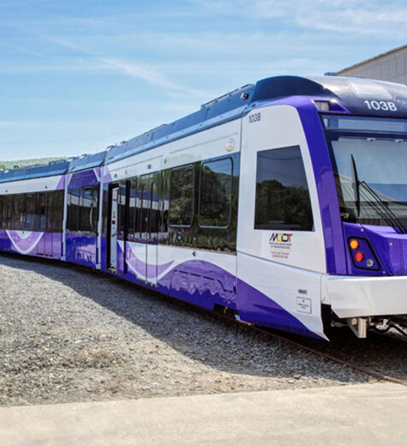
Introduction
Housing affordability in Moco
Purple line and gentrification

Slide 3
Problem statement
Demonstrate how geospatial analysis tools in ArcGIS can be used to analyze and model spatial patterns
Evaluate how transit, zoning or demographics influence Housing affordability
Assess potential future impacts of the Purple Line

Slide 4





Tools

Slide 5
Data Source
ACS (American Community Survey)
Montgomery County Planning Department
Historical GTFS Transit Data
Prediction Inputs:
Development Pipeline and Purple line Station Location

Slide 6

Data cleaning and Pre-processing
Downloaded ACS tables using API; standardized to block groups
Calculated Change in Housing affordability variable
Calculated change in independent variables of the two-time frames
Spatial joins to align zoning, permits, and transit access
Summarized transit frequency (%) per block group
Removed missing or inconsistent boundaries
What was included/ excluded?
Included:
CHAI( change in housing affordability) index
Socioeconomic, zoning, and transit variables
Second timeframe (t1) 2019–2023
Excluded:
Delta (t1–t0) variables
The first timeframe (t0) 2009–2013
Rockville & Gaithersburg

Slide 7

Descriptive Statistics
Dependent variable
CHAI: Composite in housing affordability index
It summarizes how much of income households spend on housing, combining renters and owners with mortgages
CHAI_dist = R_share × R_mean + O_share × O_mean.

Slide 8
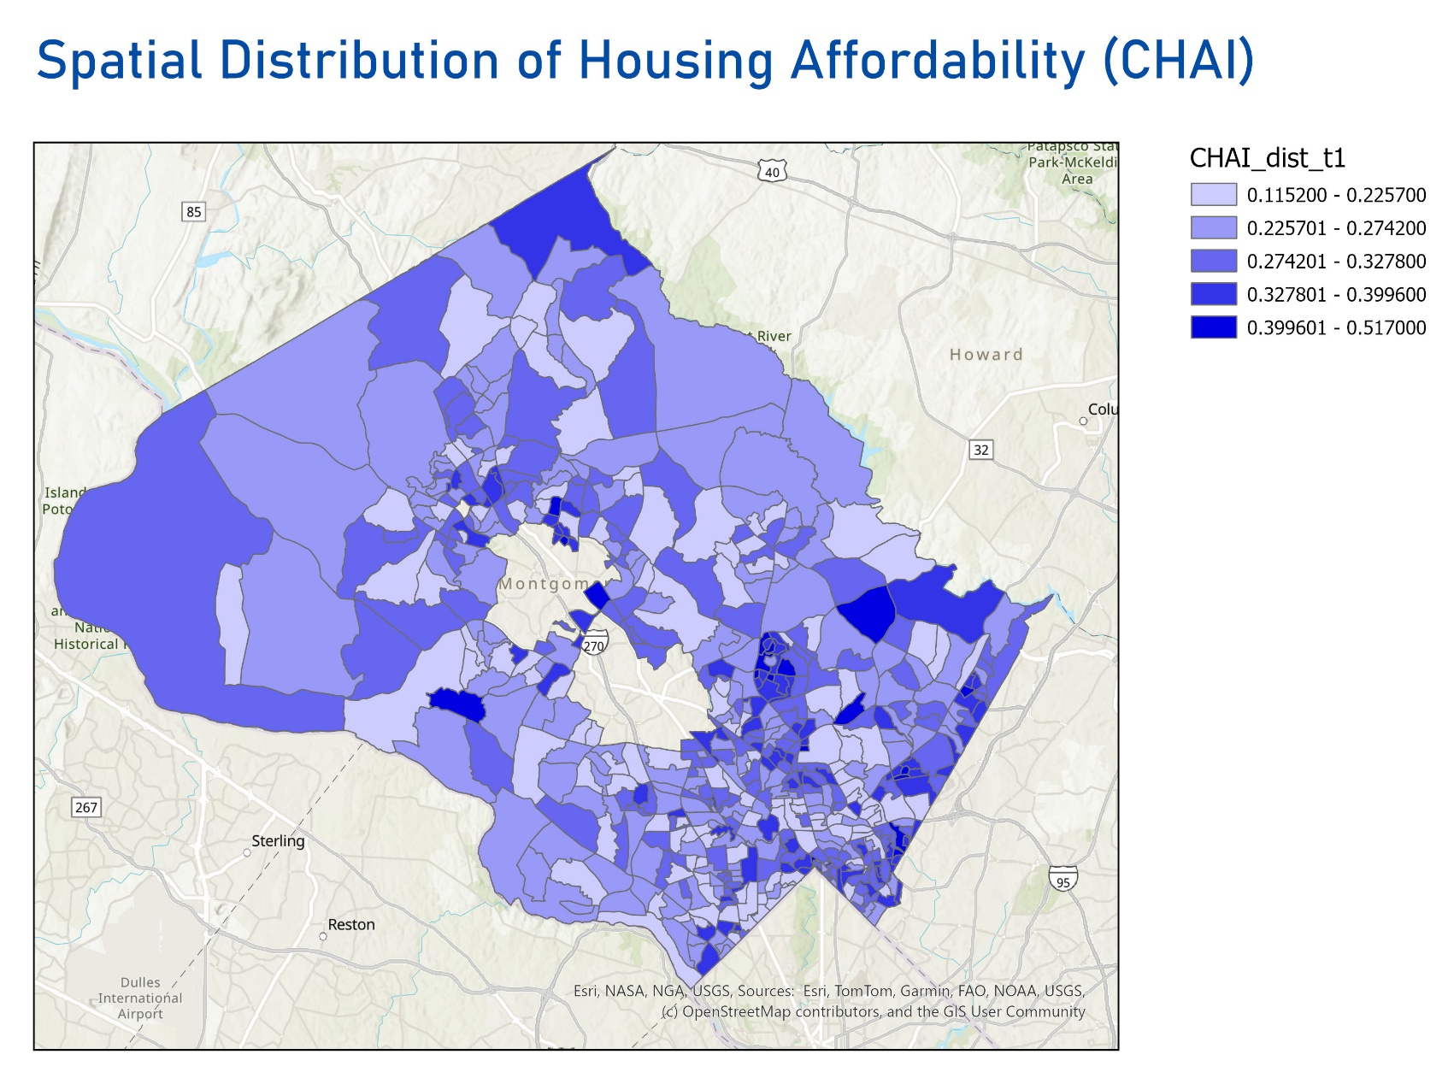
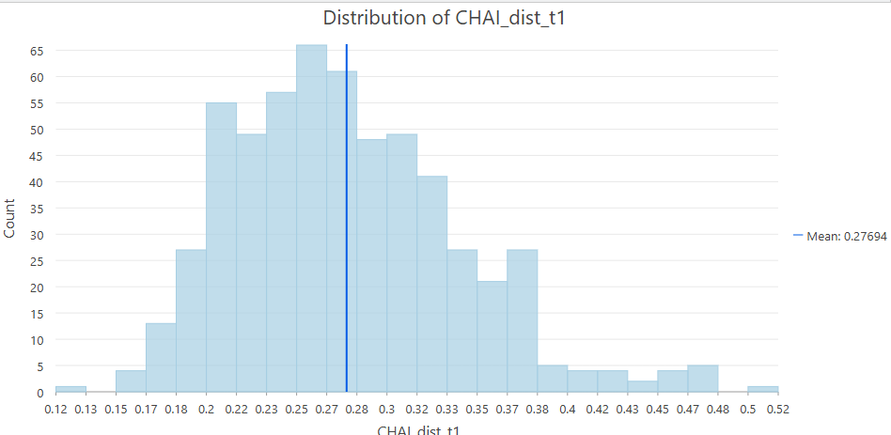

Slide 9

Independent Variables
LOWINC_SHR_: Low-income share
HIGHEDU_SHR: Higer education share
R_share: Renter Share
Zoning data
Multifamily zoning

Slide 10

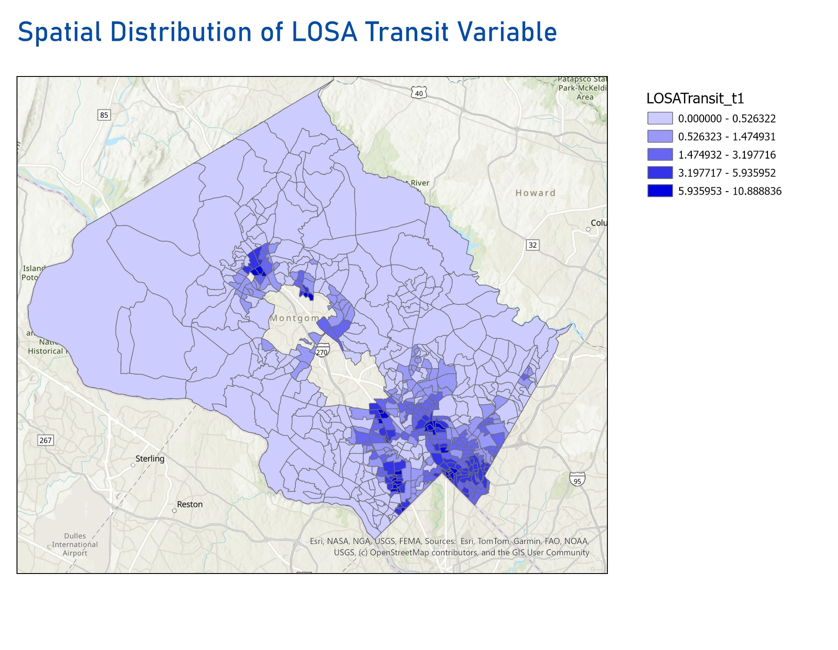
LOSATransit_t1
It is Level of service accessibility
It measures how good transit service is in the neighborhood .
Measured using Transitland GTFS data and Esri's calculate transit service frequency tool

Slide 11

Exploratory Regression
Significance of the variables
LOWINC_SHR_T1 (Low-income share):
100% significant → this variable is consistently meaningful everywhere in the county.
100% positive → higher low-income share is positively associated with our dependent variable (change in affordability).
2. HIGHEDU_SHR_T1 (Higher-education share)
100% significant → consistently useful predictor.
100% negative → the relationship is always negative.
3. R_SHARE_T1 (Renter share)
100% significant → very strong and stable variable.
100% positive → renters share is positively related to change in affordability
4. MF_ZONE_T1 (Multifamily zoning share)
61.40% significant → weak positive relationship
5. LOSATransit_T1 (Low-access transit areas)
50.88% significant
OLS model using those variables to evaluate their combined effect and compare the R².
Multiple R-Squared
0.544304
.

Slide 12
Multiscale Geographical Weighted Regression (MGWR)
Local regression model
Shows how relationships vary across space
Each variable works at its own scale
Reveals where variables matter most

Slide 13
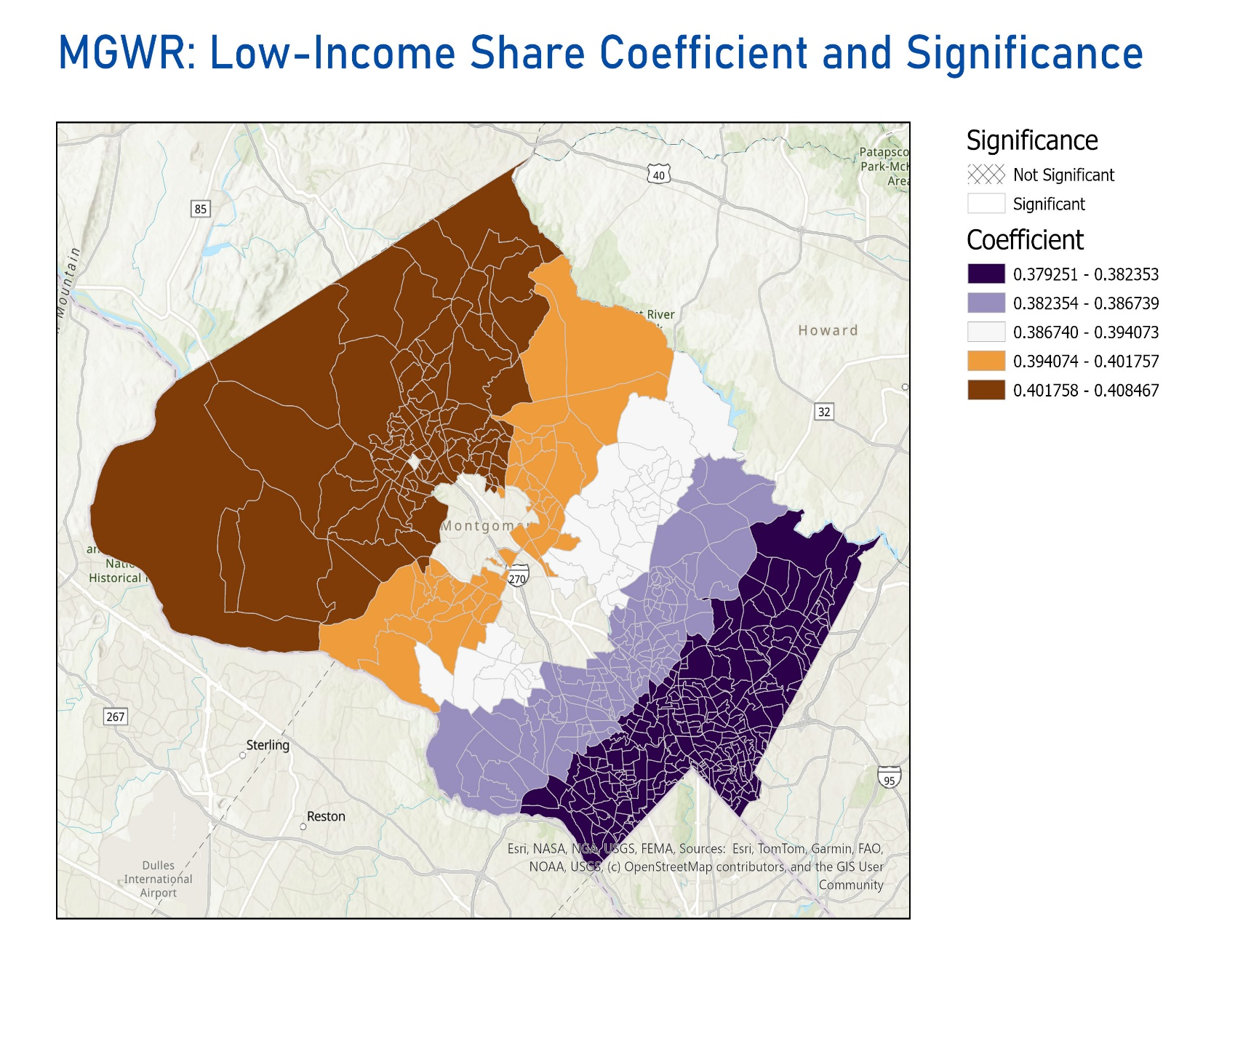

Slide 14
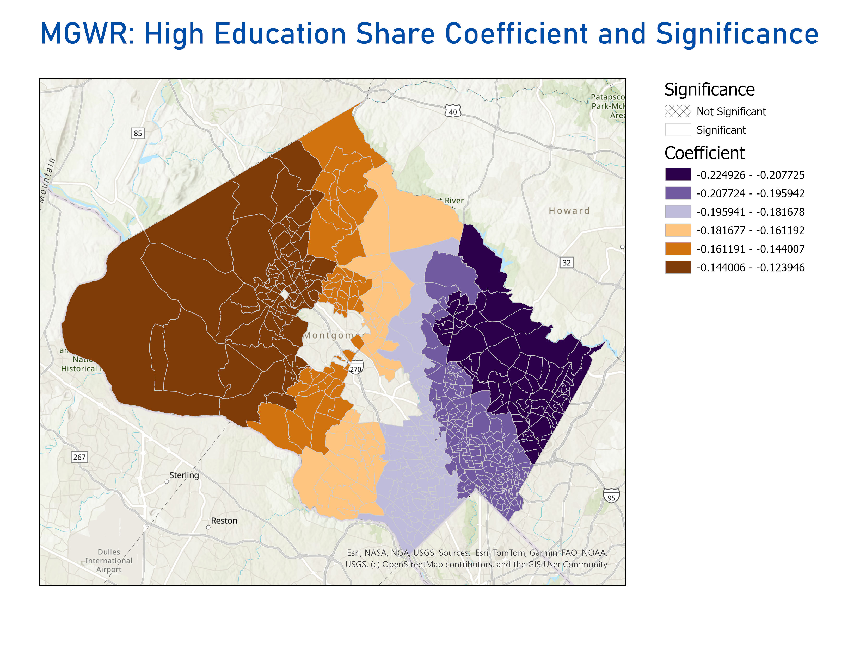

Slide 15
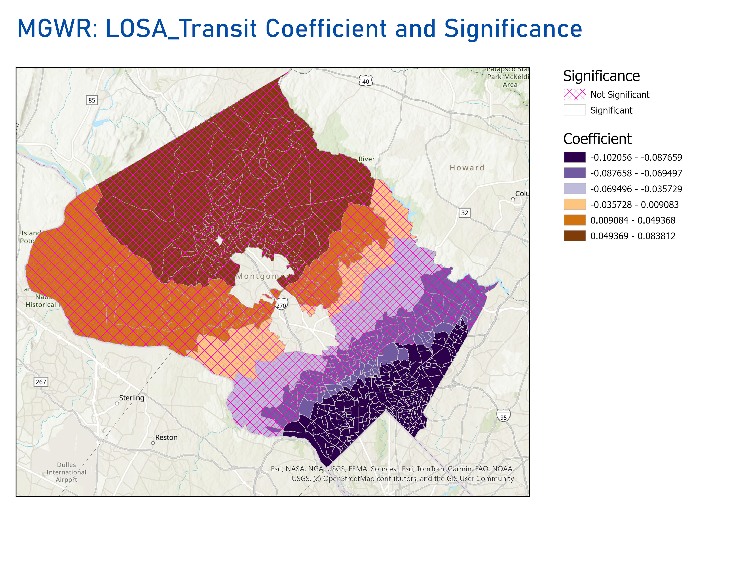

Slide 16

Prediction
Forest-Based Regression & Prediction (FBCR)
Machine learning model
Builds decision trees
Why are we using this tool?

Slide 17
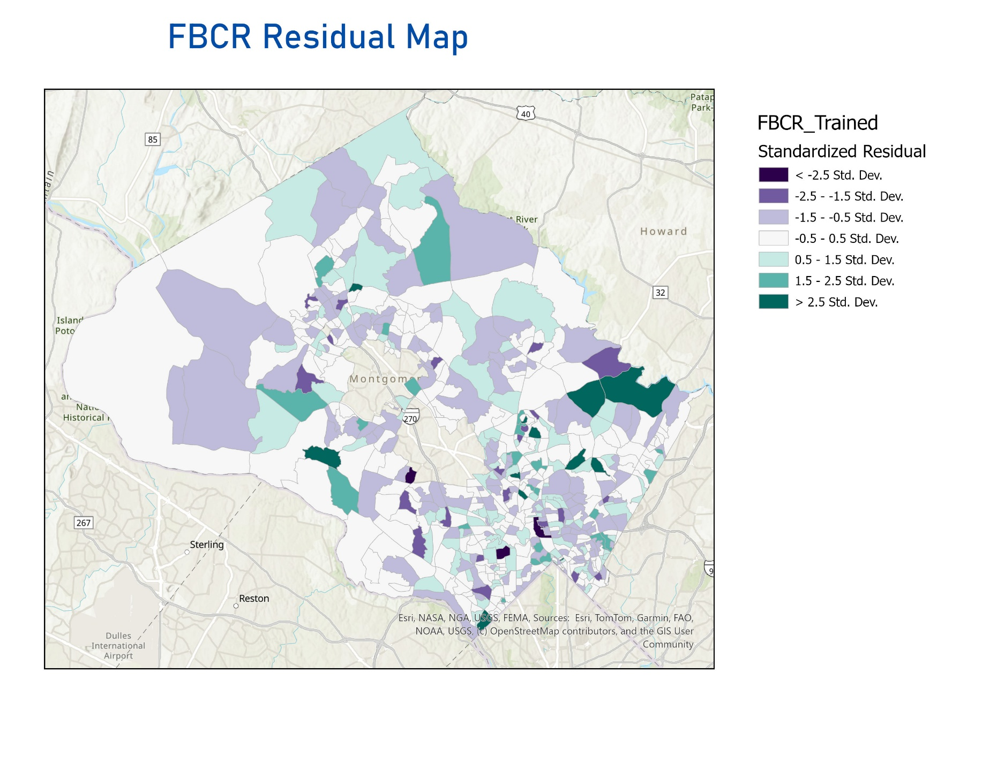
Prediction output
Transit → very weak effect, model could not predict well
The model is not capturing all local neighborhood factors,
Some important predictors may be missing
And the housing affordability patterns may be more spatially complex than what the model can learn from the input variables

Slide 18

Next steps / what we should have done better
Add more future Variable like different income variable
Add more transit data. Separate Bus line from metro line
Find a different way to measure transit ( like job accessibility by transit or so on)
Run scenario analysis (different headways, different development pipeline assumptions).
Need of housing economists/ urban planners to help with us define variables.
.

Slide 19
Acknowledgement
I would like to express my sincere gratitude to:
My sponsor, Russell – for providing mentorship that strengthened my learning experience
Professor Lori – for her continuous guidance, feedback, and support throughout this entire project.
The team at Montgomery County Government office for offering valuable data resources, insights, and an opportunity to work on a real-world project that has deep community impact.
Montgomery College and Professor Saidi – for providing this wonderful opportunity and for supporting my academic and professional development.

Slide 20

Thank you!

